Slide 1
MYC Gene Analysis
ALY 6020 20942 Predictive Analytics
Group Member: Liang Shi
Instructor: Marco Montes de Oca

Slide 2
Outline
Introduction
Generalized Linear Regression
Classification & Regression Tree
Random Forest
Gradient Boosting
Conclusion

Slide 3
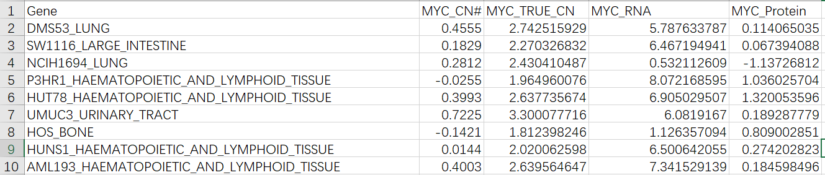
Introduction
Dataset
03-08-18-Data Summary for MYC Gene(1458 observations)
Background
Cell lines can come from different organs and each cell line has the same gene called MYC, in this case, we target at the MYC copy number, RNA expression and protein expression. Normally, when the copy number is around 2, the patient is relatively safe, while when it is much over 2, the patient will have over 70% probability to have a tumor or the tumor is out of control.

Slide 4
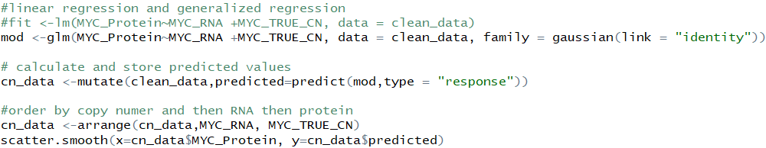
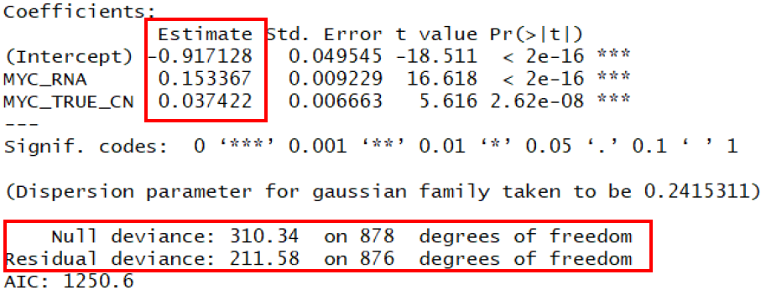
Generalized Linear Regression
Generalize A Linear Model
Result
Protein = 0.1533 * RNA_expression +0.0374 * copy_number -0.9171
Notes:
Here I choose the cleaned data which has no null value. In this case, the error distribution obeys the gaussian distribution, and that’s why I choose family function as “gaussian” and the link as “identity”.

Slide 5
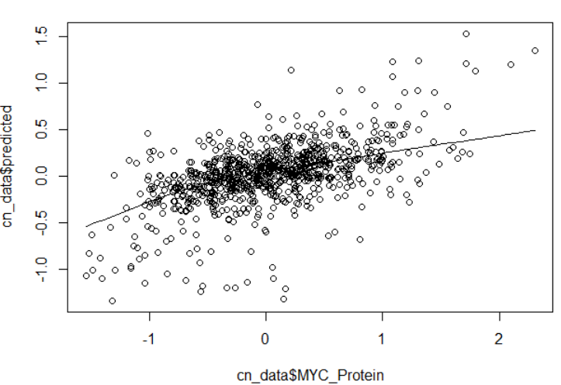
Relationship is not represents by a straight line
A linear model won’t be a great fit in this case
Notes:
The generalized linear model is contradicted to standard linear regression analysis, no assumption is made that the relationship is represented by a straight line.
The fit result is more flexible than a straight line . As we can see from the plot that it bends downward from right to left. So, in this case, it indicates that a linear model won’t be a great fit especially for the values on the lower left part. Perhaps they can be considered as “outliers”.

Slide 6
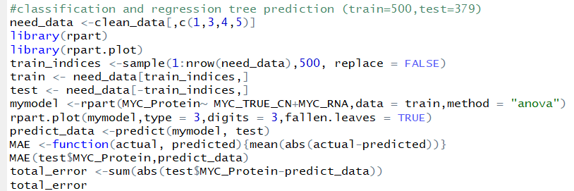
Classification & Regression Tree
Build A Tree and Make Prediction
Train Set: 500 records
Test Set: 379 records
Notes:
By classifying the cell lines by protein expression, we can see which level is relatively safe according our existing knowledge about the safe range of corresponding copy number. That’s the reason why I build the tree and make predictions.
Here I choose the method as “anova” because the dependent variable chosen here is not a factor but a number, and it only has one column, so I will not choose “class” or “poisson”. Besides, I calculated mean absolute error here to check the prediction accuracy.
.

Slide 7
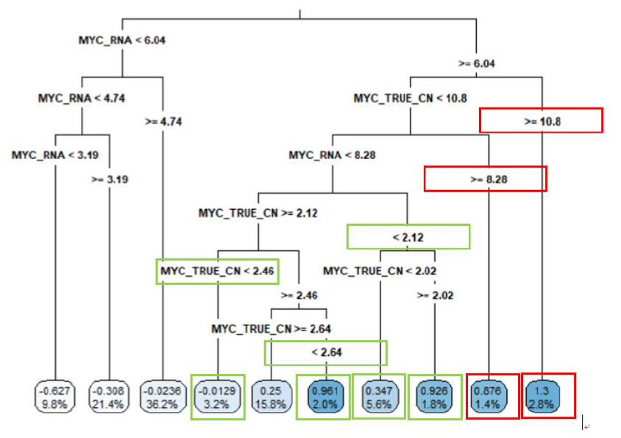
Mean absolute error is 0.407, which is a relatively low level.
Notes:
My classification tree has 10 terminal nodes in total. Out of all predictors the RNA expression is the most predictive one. Model calculated that protein expression will be split by RNA less then 6.04 and not.
Just as I mentioned before, copy number around 2 is a relatively safe level, in this case, the protein level inside the green box is the safe level which means a low probability of having tumor or the tumor is still under control, while the values inside the red box have exceed the safe region.
Mean absolute error measures the accuracy of our prediction

Slide 8
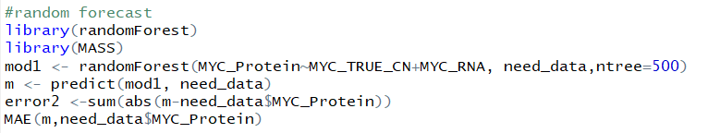


Random Forest Forecast
Construct Random Forest and Make Prediction
Forecast Result and Accuracy
Notes:
Choosing random forest to fit the function of MYC copy number and RNA expression is because I want to make the prediction more accurate and persuasive by constructing more trees and see the result. Here I define the amount of tree inside the forest is 500 and then I make a prediction basing on the new data.
I also calculate the mean absolute error here which can help to measure the accuracy as well as make comparisons between models afterwards
The mean absolute error is only 0.197 which is much lower than simple classification tree does.

Slide 9
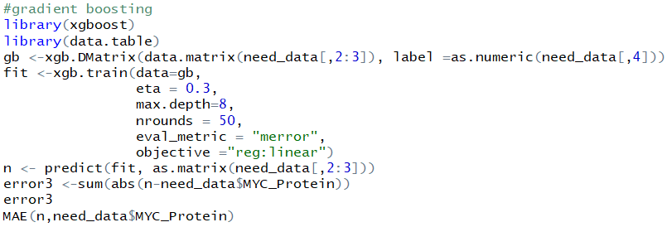


Gradient Boosting
Construct Gradient Boosting Model and Make Prediction
Forecast Result and Accuracy
Notes:
Gradient boosting is another technique for regression and classification problems, it can also be used to predict models. The difference is that it can generalize the model by allowing optimization of an arbitrary differentiable loss function, which means minimizing the loss. The reason why I choose this model is to predict the protein expression again and see which model is the best one regarding to classification and prediction issues.

Slide 10
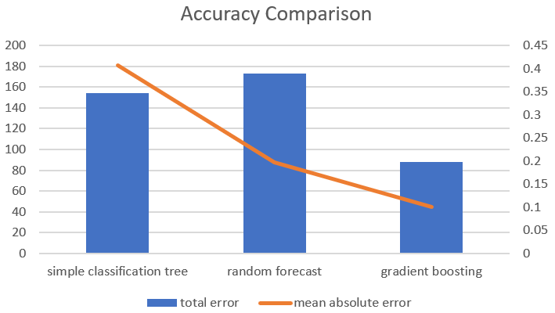
Accuracy Comparison

Slide 11
Conclusion
1. There is a relationship between the copy number, RNA expression and protein expression of MYC, while it is not a straight line.
2. When the protein expression is -0.0129, 0.961, 0.347 and 0.926 the patient is relatively safe, while if the level is 0.876 and 1.3, the possibility of having tumor is very high.
3. Gradient boosting works best in predicting protein expression.

Slide 12
My Question
1. How to set up the parameters when using gradient boosting model?
2. Theoretically, the total error should have the similar tendency as mean absolute error, while the total error of random forest is higher than that of simple classification tree. What’s the reason?

